Slide 1
DevOps Ecosystem

Slide 2
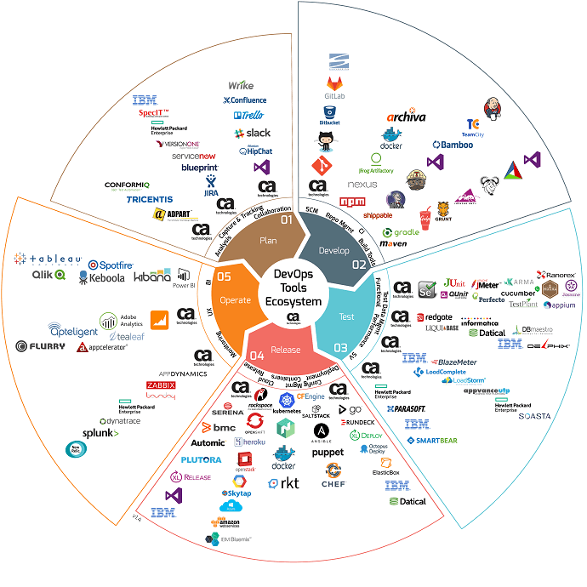
DevOps Ecosystem

Slide 3
Devops Ecosystem
DevOps is becoming a crucial part of any software product or service. Therefore, it’s no surprise that the number of tools for DevOps keeps growing, to answer all of their working needs.
The tools will be divided into the five stages of the work cycle:
Plan
Develop
Test
Release
Operate

Slide 4
Plan
Planning is the initial stage, and it covers the first steps of project management.
The project and product ideas are presented and analyzed, in groups, alone or on whiteboards.
The developer, team and organization decide what they want and how they want it and assign tasks to developers, QA engineers, product managers, etc.
This stage requires lots of analysis of problems and solutions, collaboration between team members and the ability to capture and track all that is being planned.
Planning Tools:
JIRA
HipChat and Slack
Aha

Slide 5
JIRA
Following is the functionality offered by JIRA:
Plan:
Create user stories and issues, plan sprints, and distribute tasks across your software team.
Track:
Prioritize and discuss your team’s work in full context with complete visibility.
Release:
Ship with confidence and sanity knowing the information you have is always up-to-date.
Report:
Improve team performance based on real-time, visual data that your team can put to use.

Slide 6
HipChat and Slack
HipChat and Slack are team communication tools that enable developers, product managers and any company member to chat and share screens. These tools enable personal messaging as well as group chats, channels or flows. Creating groups dedicated to different projects makes them ideal tools when instant communication is needed while working on assignments.
Aha
Aha is used for product roadmap planning. With this tool you can build a roadmap, create features, distribute tasks, grade tasks and prioritize. The planning work starts with this tool, which can then be integrated with JIRA.

Slide 7
Develop
Developing is the stage where the ideas from planning are executed into code, or in other words - the ideas come to life as a product. This stage requires software configuration management, repository management and build tools, as well as automated Continuous Integration (CI) tools for incorporating this stage with the following ones.
Following are the common tools used in development phase:
Development Tools:
Version Control System Management (Git-Hub and Bit-Bucket)
Package Management (NPM)
Continuous Integration – Jenkins

Slide 8
Version Control System
What is version Control System?
Version control systems let you host your code, share it with other developers and collaborate on them.
Bitbucket and GitHub are two of the most popular version control system management services. Both were launched in 2008, while Bitbucket was acquired by Atlassian in 2010.
Which one should you choose?
That depends on your needs. The main differences are that GitHub is open-source friendly, as it enables an unlimited number of collaborators for public repositories. But if you need private repositories, Bitbucket offers them for free, for up to five collaborators. GitHub also supports only Git revision control, while Bitbucket supports Git and Mercurial. Git, however, is usually enough for developers.

Slide 9
Package Management (NPM)
What is Package Management?
Package management enables developers to reuse and share code through repositories, which store “packages”. Packages are files or directories that are grouped together to provide a service or functionality. Founded in 2014, NPM is an open-source product.
Pros - Most packages in one place, easy to use
Cons - Requires all packages to be on the NPM website

Slide 10
Continuous Integration (Jenkins)
What is Continuous Integration?
Jenkins is an open-source Continuous Integration tool that enables developers to automate their tests every time they commit a new build.
Pros - open-source,easy to get started with, runs tests in parallel, integrates with many tool, including JMeter and Taurus
Cons - Plain UI

Slide 11
Test
A crucial part that examines the product and service and makes sure they work in real time and under different conditions, even extreme ones sometimes. This stage requires many different kinds of tests, mainly functional tests, performance or load tests and service virtualization tests. It’s also important to test compatibility and integrations with 3rd party services.The data from the tests needs to be managed and analyzed in rich reports, for improving the product according to test results..
Following are the common tools used in testing:
Testing Tools:
Load Testing - JMeter
Load Testing - CA BlazeMeter
Functional Testing – Selenium
Functional Testing - Perfecto Mobile

Slide 12
Load Testing - JMeter
Following is the functionality offered by JMeter:
JMeter is the most popular open-source load testing tool.
JMeter enables users to create a test scenario that contains the actions and requests they want to test on their website or app.
Then, the can modify it according to their business needs with elements like ramp-up time and timers, run it for multiple users and examine the results.
Pros - open-source, easy to use, robust, has a vibrant and involved support and development community, has multiple plugins and integrates with Continuous Integration tools like Jenkins
Cons - requires downloading, limited scalability, limited reporting, creating a test scenario can be meticulous

Slide 13
Load Testing - CA BlazeMeter
Following is the functionality offered by BlazeMeter:
CA BlazeMeter has all the abilities JMeter has since it’s an enhanced and upgraded version of JMeter.
Pros - scalability (JMeter in the cloud), advanced reporting, collaboration options, multiple plugins and test recording features
Cons - not open-source

Slide 14
Functional Testing – Selenium
Following is the functionality offered by Selenium:
Selenium is an open-source functional testing tool, which automatically tests browsers and enables testing of web applications.
Pros - open-source, supports a variety of languages, operating systems and browsers, records scripts (through Selenium IDE), works with JMeter
Cons - requires high expertise to use, does not support windows based applications, lacks online support

Slide 15
Functional Testing - Perfecto Mobile
Following is the functionality offered by Perfecto Mobile:
Perfecto Mobile is a functional testing tool for mobile apps, which runs automated app tests on real devices.
Pros - High optimization and accuracy due to running tests on real devices
Cons - Testing speed can be slow

Slide 16
Release
The “Release” stage takes place through all the layers of the infrastructure and the company. It includes deployment tools, containers and release tools, as well as configuration management and Cloud foundation for scalability. The release stage takes us from code to working product.
Following are top tools for release stage:
Release Tools:
Configuration Management - Chef, Puppet & Ansible

Slide 17
Configuration Management - Chef, Puppet & Ansible
Configuration management lays the groundwork for the app and its dependencies, by tracking and updating information about hardware and software. It can also be used for continuous deployment strategies by automatically distributing changes.
Chef, Puppet and Ansible are three similar tools that help you build strong and automated infrastructure by IT automation that operates and deploys your infrastructure.
Which one should you choose?
In Chef and Puppet the language/DSL is more flexible than Ansible’s yaml files. But, it’s hard to manage multi DC masters and replication. In addition, these systems need to manage another PKI (public key infrastructure), unlike Ansible which uses an existing infrastructure. This makes the infrastructure management more complex.
Ansible can run ad-hoc commands, it enables simple reading and writing using yaml files, it’s agentless, and the PKI is already there if you have ssh access to the machines. However, in Ansible yaml files are strict and prone to indentation errors.
In general, for all config management tools, every change has to run dynamically on the servers, but they might break at runtime. The solution for the runtime issue is immutable infrastructure provided by the containers.

Slide 18
Operate
Operating is the stage that ensures maximization of the product’s abilities after it is up and running. This includes monitoring the UX, monitoring infrastructure, APMs and aggregators, and analyzing Business Intelligence (BI).
Here are our top tool recommendations for the operating stage:
Application Monitoring (APM) (New Relic, CA APM, AppDynamics and DynaTrace)
Application monitoring (APM) monitors the inner parts of the application, including the language’s garbage collection performance, stack traces and the time it took to query databases and additional micro-services. This ensures smooth operation and the ability to track usage trends and system health.
Infrastructure Monitoring - (Prometheus, Sensu, Zabbix and sysdig)
Infrastructure monitoring provides insights into your underlying infrastructure and monitors server load, CPU, memory and more. It also examines connectivity between services, databases and external systems. If you need to drill down to the root cause, you can also use aggregated logging services such as ELK/Splunk and for visualizing events.

